Slide 1

Design of an Alpha-Numeric Text Editor with
PC communication
Perini Alpár
Technical University of Cluj-Napoca
Computer Science

Slide 2
Design Objectives
Basic text editor functions
Keyboard controller
Change font colors
Display controller: 640x480@60Hz
Text file to/from a PC
API on PC to send/receive text file

Slide 3
Requirements
Hardware:
  PS2 keyboard & module
  Switch module
  VGA CRT color display
  VGA module
Software:
  Windows OS
  Adept Suite
  EditorDpim API

Slide 4
Project Implementation
Developed in Xilinx Web Pack 7.1&8.1 ise using the VHDL language
Target: Spartan3 FPGA
API for file transfer written in Visual C++ 6.0 using the MFC and the Adept SDK
3 main modules:
  Display
  Keyboard
  Communication

Slide 5
Display
CRT – moving electron beam
Info displayed on ‘forward’ direction
Video data → video refresh memory
Generate HS and VS timings
Pixel clock → time for 1 pixel
VS → ‘refresh’ freq.
No. of lines to be displayed → horizontal ‘retrace’ freq.

Slide 6
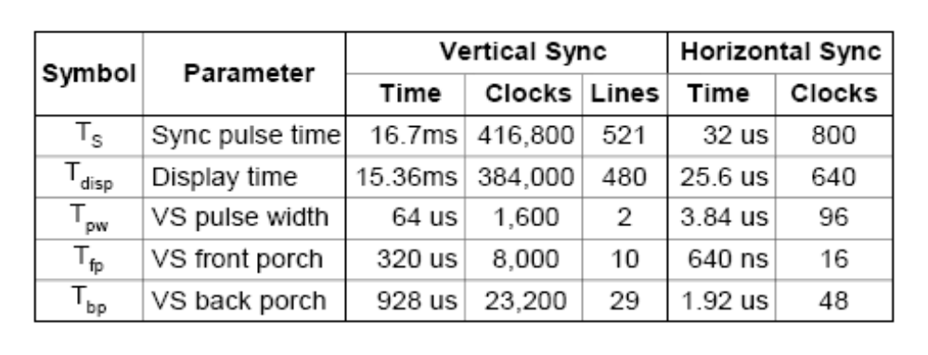
Display (2)
640x480@60Hz with 25MHz pixel clock:

Slide 7
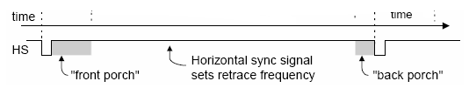
Display (3)
VGA observations derived timings for:
  Sync pulse width
  Front & back porch intervals: info cannot be displayed

Slide 8
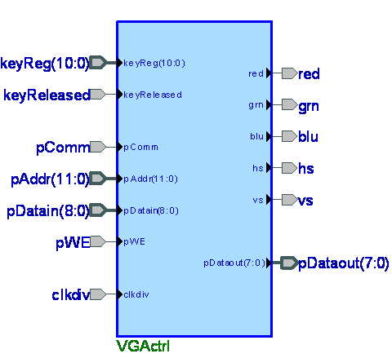
Display Black Box

Slide 9
Display (4)
Two counters → video RAM address
Visible area starts at value 0
Characters 8x8 pixel patterns → ROM
Column number: hc/8 (80 chars/line)
Line number: vc/16 (30 lines – every second line empty)
Continuous addresses by ALU:
no of lines * 80 + column no

Slide 10
Display (5)
Least sign. 3 bits → demultiplex the actual pixel
Pixel & vidon → red, grn, blu activated
Chars not displayed one after the other, but line by line
Colors → 3 more bits in RAM from switches
Uses the read port of the dual-port RAM

Slide 11
Keyboard
Uses a two-wire bus: KD, KC
Keys → unique scan codes
Key released → ‘F0’ key-up code sent
Keyboard sends only when KD and KC are high
Data sent in 11 bit words:
  ‘0’ start bit
  8-bit scan code (LSB)
  Odd parity bit
  ‘1’ stop bit

Slide 12
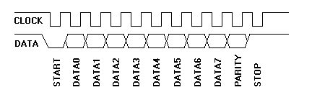
Keyboard (2)
generates 11 clock transitions – at around 20 - 30KHz – when the data is sent
data is valid on the falling edge of the clock

Slide 13
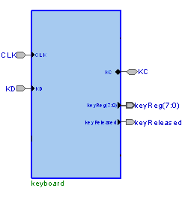
Keyboard Module

Slide 14
Keyboard (3)
System clock divided down
KD and KC sampled
data received is shifted on the falling clock edge (from the left) into two shift registers in series
If second register contains the ‘F0’ key code → key was released → data stored in the first register should be a valid scan-code → prepared for output along with the handshaking signal keyReleased

Slide 15
DPIM
Allows Windows PCs to exchange data with logic implemented on the board
Application programs depend on the data interchange API functions in dpcutil
Operation depends on the implementation of the appropriate interface logic in the gate array

Slide 16
DPIM (2)
Logic implements a set of registers in the gate array
An application on the host PC exchanges data with the design in the gate array by reading or writing these registers
Interface provides an 8 bit bi-directional parallel data bus and six handshaking lines to control the data transfer
1 address register
Up to 256 data registers

Slide 17
DPIM (3)
Four types of transfer cycles:
  address read,
  address write,
  data read,
  data write
Direction controlled by nWRITE
All bus cycles are initiated and controlled by the host

Slide 18
DPIM (4)
WAIT signal is used to synchronize transfers
host will not begin a transfer unless the WAIT signal is low
Host holds the strobe until WAIT goes high
WAIT going high → peripheral completed processing
Host brings strobe to inactive state
Peripheral brings WAIT low when it is ready

Slide 19
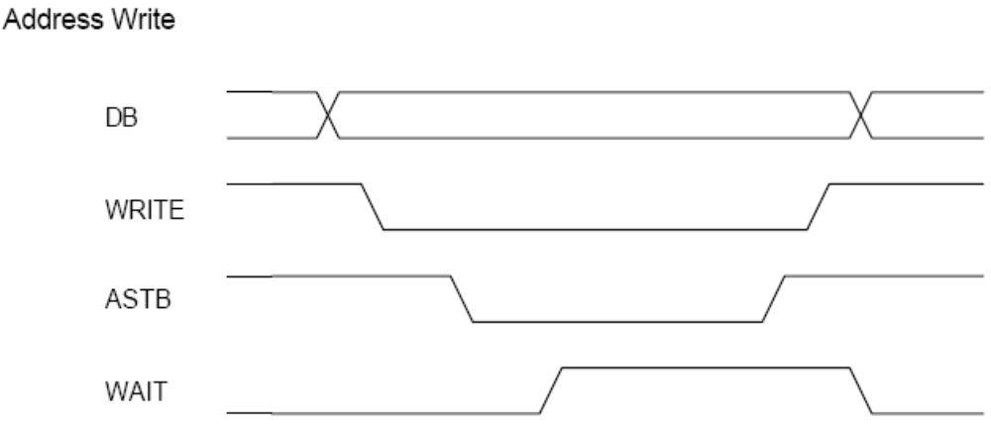
DPIM (5) – Address Write

Slide 20
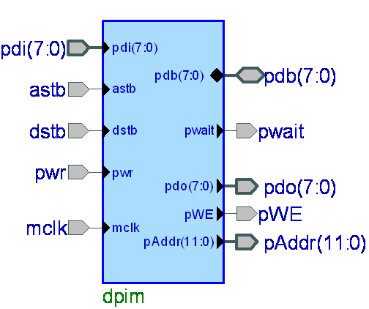
DPIM black box

Slide 21
EditorDpim API
Windows executable
Only one default device, the one that is being tested
Radio buttons to select transfer direction
Browse button to select the text file
Perform button executes the command

Slide 22
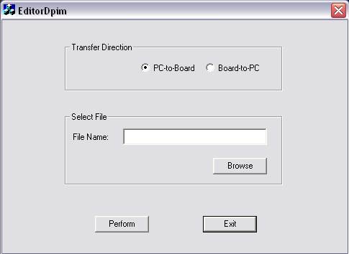
EditorDpim API (2)

Slide 23
Editor Main Block
Editing the contents of the video RAM requires a cursor and signals from the keyboard logic
Cursor address stored in two registers
Content modified according to the type of key that was pressed
Scan-codes can be received even when the unit is displaying characters
They are converted to ‘ascii-like’ codes

Slide 24
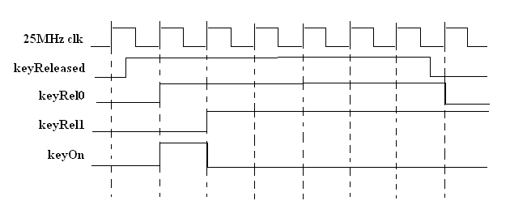
Editor Main Block (2)
They are input to port A along with the color switches
At this time the WE signal has to be active (but only for 1 clk cycle)

Slide 25
Editor Main Block (3)
MUX to allow R/W to/from DPIM module
pComm selection
  low: keyboard has RAM access
  high: communication module has access
WE, address & dataIn are multiplexed
DPIM’s MAR incremented when a WE or RD pulse was active & reset when full data processed

Slide 26
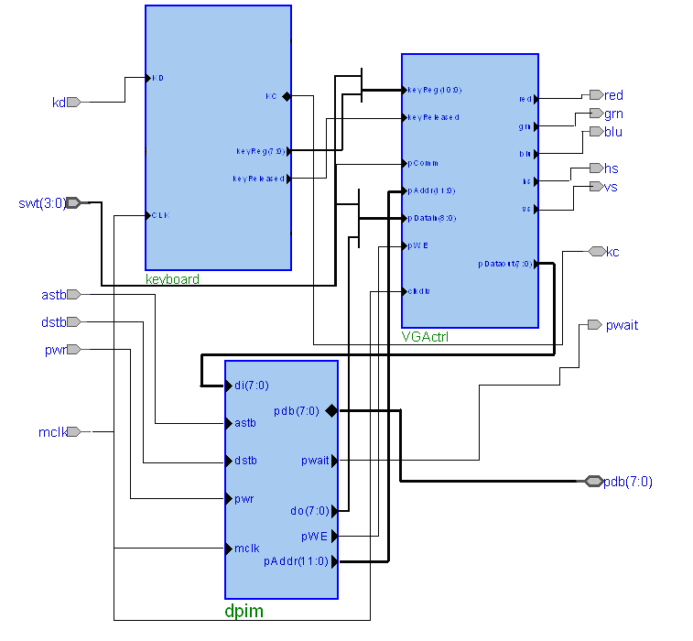
Interconnection Schematic

Slide 27
Editor Main Block (4)
Switches 1-3: font color
Switch 0: communication on/off
System clock oscillator 25MHz!
3 main modules had to be implemented as a whole because only this way did the Web Pack produce a fully functional and stable design

Slide 28
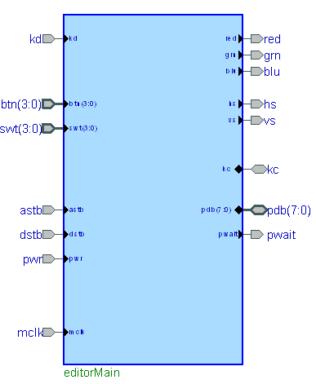
Editor Main Block (5)

Slide 29
Design Summary
Only a few components could be tested separetely
Most of them required to be tested on the board
Timing summary:
  Minimum period: 14.229ns (Maximum Frequency: 70.279MHz)
  Minimum input arrival time before clock: 6.610ns
  Maximum output required time after clock: 26.255ns
  Maximum combinational path delay: 11.138ns

Slide 30
References
Digilent Pegasus Demo containing modules for display and keyboard that could be reused: Pegausdemo.zip
Character Map ROM for displaying the characters: chmap.doc
Digilent Parallel Interface Model Reference Design: dpimref.vhd
Digilent Adept SDK -- libraries and demo: AdeptSDKv1-2.exe
DIO4_rm.pdf – keyboard and display theoretical background
DpimRef.pdf – DPIM description and functioning

Slide 31
Thank you for your attention

